Slide 1
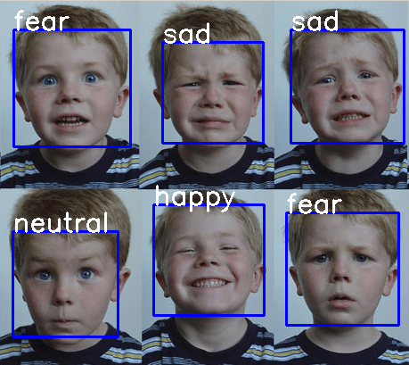
FACIAL EXPRESSION RECOGNITION USING LOCAL DIRECTIONAL TERNARY PATTERN
BATCH NO : 04
CH. Teja Srinivas Y19IT016
K. Harshavardhan Y19IT062
A. Shyam Sundar Y19IT001
Guided By
Smt. N. Neelima Mam

Slide 2
CONTENTS
Abstract
Index Terms
Introduction
Existing Methods
Proposed Method
Results
Conclusion
References

Slide 3
ABSTRACT
The automatic recognition of emotion has been an important field in computer vision. One of the key techniques for recognizing emotions automatically is facial expression recognition, which detects and analyses human emotions from facial images. Facial expressions can be represented by appearance changes on the face. Consequently, describing them exactly is the key issue in facial expression recognition for detecting emotions. This project proposes a new face descriptor, Local Directional Ternary Pattern (LDTP), for facial expression recognition. Motivated by the high edge responses in the boundaries of the emotion-related facial features, edge directional patterns in a face image are generated, while avoiding smooth regions (meaningless for expression recognition), by using the magnitude of the edge response. Experiments are carried out on facial expressions on the CK+ dataset. Performance analysis is performed and the results obtained are good.

Slide 4
Key Words
Face Descriptor
The system will assess the shape, and proportion of parameters on the user's face, such as the gap between the user's eyes, nose, mouth, ears, and jaw, as well as the scale of the user's eyes, mouth, and other facial expressions based on the information stored prior in the database.
Local Pattern
A local pattern considers the variations of the subregion in an image, which is also called a micropattern.

Slide 5
Expression Recognition
Expression recognition provides machines with a way of sensing emotions that can be considered one of the most used artificial intelligence and pattern analysis applications.
Edge Pattern
An edge in an image is a significant local change in the image intensity, usually
associated with a discontinuity in either the image intensity or the first derivative of the image intensity.
Face Recognition
Face detection is a computer technology being used in a variety of applications that identifies human faces in digital images.
Face detection also refers to the psychological process by which humans locate and attend to faces in a visual scene.

Slide 6
INTRODUCTION
In today’s widely emerging technological era, the automatic recognition of emotion has been an important field in computer vision as it has a wide range of applications.
Facial expressions can be represented by appearance changes on the face. But describing them exactly is the key issue in facial expression recognition for detecting emotions.
A new face descriptor which is a Local Directional Ternary Pattern for facial expression recognition to overcome all the problems with the traditional facial expression recognition systems.
The main advantage of using this method is the using of new coding scheme that increases spatial information with the active edge pattern, and consequently improves the classification result.

Slide 7
EXISTING METHODS
Face Description with Local Binary Patterns
Facial Expression Recognition Using PCA and Texture-Based LDN Descriptor

Slide 8
FACE DESCRIPTION WITH LOCAL BINARY PATTERNS

Slide 9
Step -1 Finding Local Binary Patterns
In this method Local Binary Patterns(LBP) are used to extract the facial descriptor.
Local Binary Pattern means the operator assigns a label to every pixel of an image by thresholding the 3X3-neighborhood of each pixel with the center pixel value and considering the result as a binary number.
The main idea of using this LBP is its invariance to monotonic gray-level changes and computational efficiency, making it suitable for demanding image analysis tasks.
In this the face image is divided into several regions from which the LBP feature distributions are extracted and concatenated into an enhanced feature vector to be used as a face descriptor.
The following figure shows the basic LBP operator.

Slide 10
A local binary pattern is called uniform if the binary pattern contains at most two bitwise transitions from 0 to 1 or vice versa when the bit pattern is considered circular. For example, the patterns 00000000 (0 transitions), 01110000 (2 transitions).
In the computation of the LBP histogram, uniform patterns are used so that the histogram has a separate bin for every uniform pattern and all nonuniform patterns are assigned to a single bin.

Slide 11
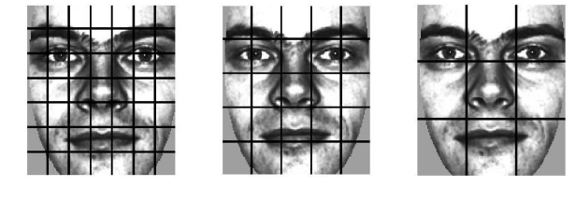
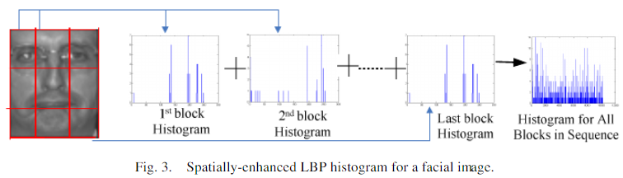
Step-2 Face Description with LBP
The procedure consists of using the texture descriptor to build several local descriptions of the face and combining them into a global description.
The facial image is divided into local regions and texture descriptors
are extracted from each region independently. The descriptors are then
concatenated to form a global description of the face. It is an example
of a facial image divided into rectangular regions.
The basic histogram is computed for every region that is further extended to a spatially enhanced histogram which encodes both the appearance and the spatial relations of facial regions.
In the spatially enhanced histogram, The effective description of the face on three different levels of locality
1. Pixel-Level
2. Regional Level
3. Global Level
Each element in the enhanced histogram corresponds to a certain small area of the face.
Division of Facial Image into sub-regions
Spatially Enhanced LBP Histogram for Facial Image

Slide 12
ADVANTAGES :
LBP is its invariance to monotonic gray-level changes and computational efficiency, making it suitable for demanding image analysis tasks.
Local Descriptors are robust to illumination changes.
DISADVANTAGES
Using larger local regions increases the robustness to errors.
Smooth regions are also considered for the evaluation.

Slide 13
Facial Expression Recognition Using PCA and Texture-Based LDN Descriptor

Slide 14
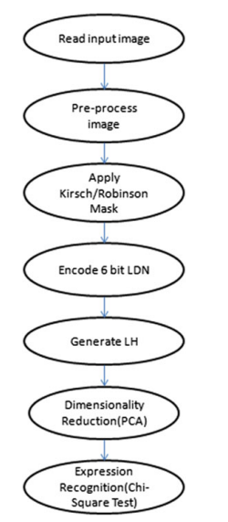
In this method, local directional number pattern(LDN) which is a local texture-based descriptor is used for encoding the directional information of the face textures.
Each pixel of the input image is represented as a 6-bit binary code.
It helps to distinguish among similar structural patterns that are having
different intensity transition.
The main phases that are used to recognize facial expressions in this
method includes
Preprocessing Phase
LDN code generation Phase
Histogram generation Phase
Dimensionality reduction Phase
Facial expression recognition Phase

Slide 15
Pre-processing Phase
In this phase, This method uses a face images from the CK+ dataset. In order to obtain the region of interest, i.e. only the face region and to eliminate background Viola-Jones algorithm is used and then crops the face region. This extracted image is then used for further processing thus reducing the computation time.
LDN Code Generation Phase
For generating the LDN code compute the edge response of the neighborhood using a compass mask as it helps to gather information in the 8 directions.
In this method the usage of two compass masks namely Kirsch and Robinson masks are used to extract the facial features.
Kirsch mask helps to reveal the structure of the face and also it is robust against noise.
The edge magnitude is equal to the maximum value found by the convolution of each mask with the image. So the edge direction is defined by the mask that produces the maximum magnitude.
To generate LDN code, analyze the edge response of each mask which represents significant edges in its respective direction. Identify the highest positive and negative values.
LDN is the concatenation of minimum and maximum directions.

Slide 16
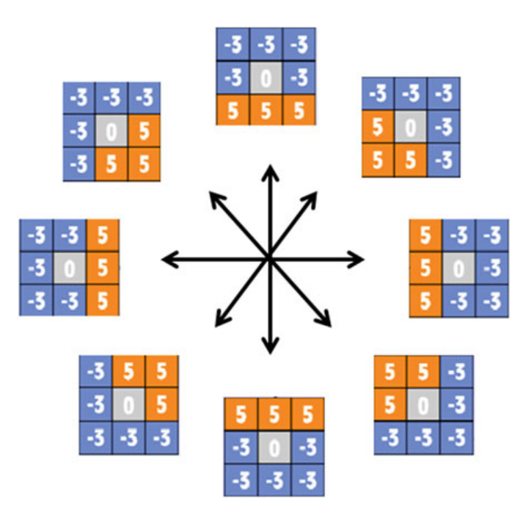
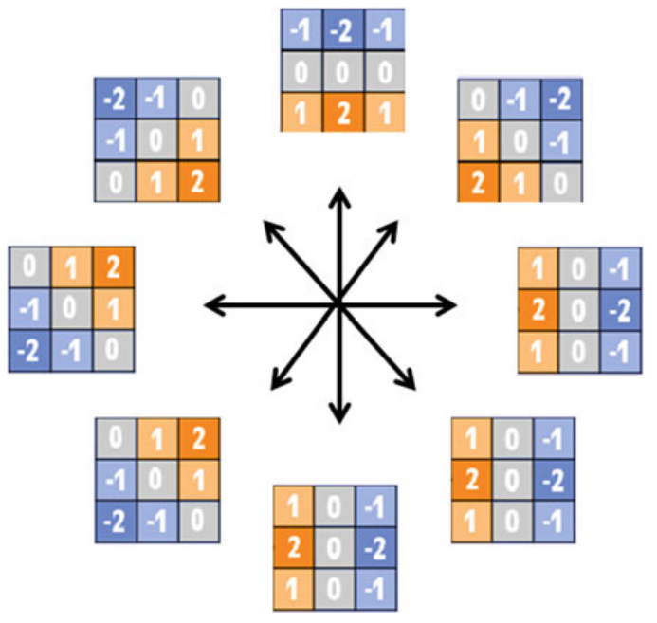
The following figure is the Kirsch mask rotated 45° apart to obtain edge response in 8 different directions.
KIRSCH MASK ROBINSON MASK

Slide 17
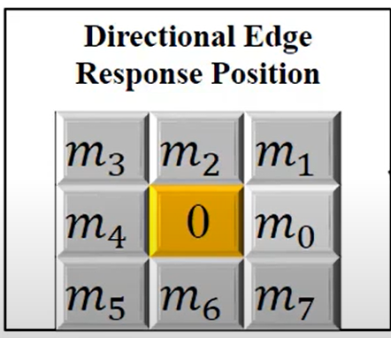
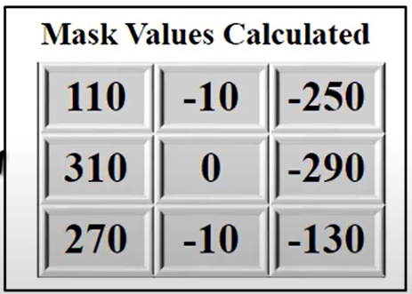
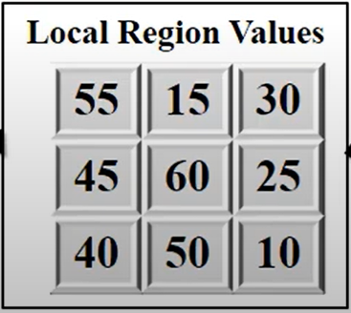
310 -> m4 , 10 -> m6
m6 -> 6-> 110 & m4->4-> 100
After concatenation of minimum and maximum magnitude values
LDN Code: 110100

Slide 18
Encode prominent regions i.e. binary codes are the binary numbers of the directions that they represent.
In Robinson’s compass mask there is no fixed mask whereas in Kirsch’s compass mask has a standard compass mask.
Direction | Binary Number
East | 000
North-East | 001
North | 010
North-West | 011
West | 100
South-West | 101
South | 110
South-East | 111

Slide 19
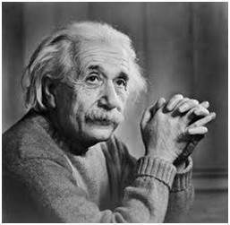
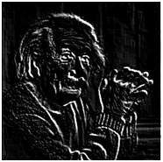
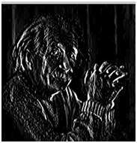
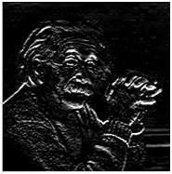
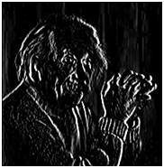
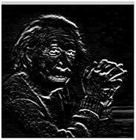
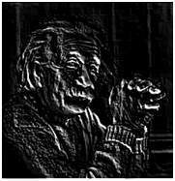
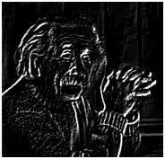
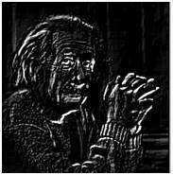
Sample Picture North West Direction Edges South Direction Edges East Direction Edges
North Direction Edges West Direction Edges South East Direction Edges North East Direction Edges
South West Direction Edges ->
Robinson Compass Mask

Slide 20
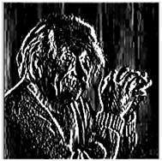
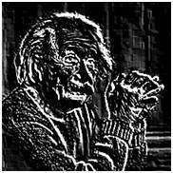
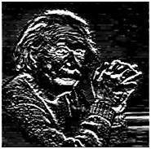
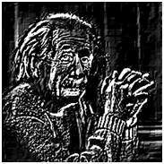
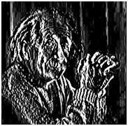
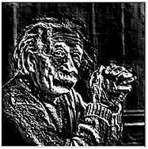
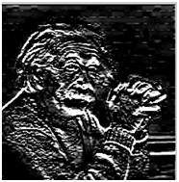
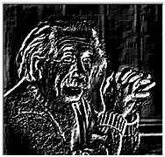
Sample Picture North Direction Edges North West Direction Edges West Direction Edges
South West Direction Edges South Direction Edges South East Direction Edges East Direction Edges
North East Direction Edges->
Kirsch Compass Mask

Slide 21
Histogram Generation Phase :
Each face is represented using LDN Histogram (LH). It contains fine to coarse information about an image, such as spots, edges, corners, and other local texture features.
To extract location information, first divide the LDN image into small regions {R¹, R² …R^{N}}. Then extract histogram H^{i} from each region R^{i} which represents minute details about local features of the face. We can divide the image into 3 × 3, 5 × 5, and 7 × 7. After obtaining a histogram from each block, concatenate these histograms which represent local features to form a global descriptor called LDN Histogram (LH).
LDN Histogram
Computation of LDN code

Slide 22
Dimensionality Reduction Phase :
Principal Component Analysis (PCA) is a Dimensionality Reduction technique that enables you to identify correlations and patterns in a dataset.
Principal components analysis (PCA) searches for k in n-dimensional orthogonal vectors that can be used to represent the best data, where k ≤ n. It can be applied to ordered and unordered attributes, and can also handle sparse data.
Data of more than two dimensions (multidimensional data) can be reduced to two dimensions in order to handle the problem. The dimensionality of LH can be reduced using PCA, i .e the number of bins in the LDN histogram is reduced in such a way that the most prominent features are extracted.

Slide 23
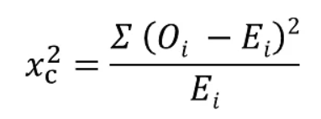
Facial Expression Recognition Phase
The main objective is to compare an encoded feature vector of the test image with the feature vectors that are already trained.
First, train the basic 6 expressions of an individual, and when a test image is given as input, it compares the data that are already trained and returns which expression corresponds to that image.
This can be done with the help of the chi-square dissimilarity test.
Formula For Chi-Square Test:
Where
c = Degrees of freedom
O = Observed Value
E = Expected Value

Slide 24
Advantages
This method exhibits an average time of 8.32s for expression recognition.
LDN helps to distinguish among similar structural patterns having different intensity transitions.
Disadvantages
The main drawback of this method is that some of the irrelevant features are also extracted which reduces the efficiency.

Slide 25
PROPOSED METHOD

Slide 26
A new face descriptor Local Directional Ternary Pattern(LDTP) for facial expression recognition is introduced in this project.
Generally, there are two main approaches to describing facial images geometric-feature-based and appearance-feature-based methods.
The first method can describe the facial image efficiently using a few features and is invariant to the scale and rotation however the second method eradicates this problem by applying filters on the whole facial image (holistic) or some specific regions(local).
In local methods Extracting edge-based local features in the smooth regions of the face image makes unstable patterns that are sensitive to noise and contribute negatively to the classification result in order to overcome it more spatial information about the facial features is needed.
To increase spatial information in the histogram representation, the number of uniform regions should be increased. However, increasing it will accumulate the sampling error for the codes with a lack of samples which will result in decreasing overall recognition performance.

Slide 27
The performance degradation is more significant at the smooth region where no prominent and stable edge patterns exist.
In order to eradicate all these problems a new face descriptor is proposed, Local Directional Ternary Pattern (LDTP), for facial expression recognition as they give high edge responses in the boundaries of the emotion-related facial features.
The smooth regions don’t contribute to this proposed method as they got eliminated using the magnitude of edge response.

Slide 28
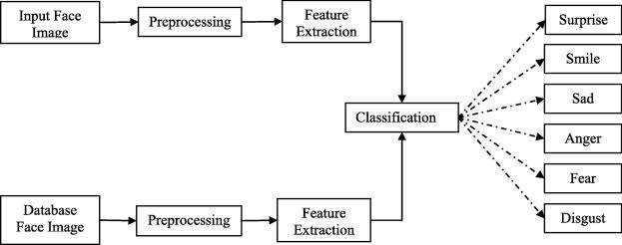
Block Diagram for Facial Expression Recognition

Slide 29
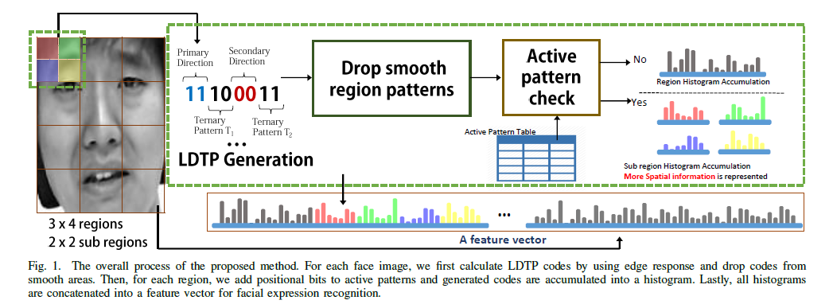
Overall Procedure of Proposed Method for Feature Extracion

Slide 30
First extract two main edge directions as directional patterns at each local pixel and utilize them to extract a local feature only if the edge response is higher than a threshold determined from experiments.
Now add a ternary pattern to each directional pattern. To encode the validation and sign information of an edge direction.
After this method selects active edge patterns which have significant accumulation for histogram and positional variation among facial expressions.
Based on the selected active edge patterns, a new coding scheme that increases spatial information while suppressing the sampling error, which results in better classification performance in overall recognition.
The proposed coding scheme assigns positional bits only to the active edge patterns with significant accumulation to get the effect of using a finer grid for the selected codes which increases the overall performance by applying the finer grid to the active patterns

Slide 31
Algorithm for LDTP Code Generation
INPUT : Image
OUTPUT : Facial Features
Step-1 : Obtain Response image with the help of Robinson Compass by using convolution
This approach adopts Robinson compass masks as an edge operator to calculate edge responses efficiently to overcome the problem of changing the facial features according to the expression.
The following are the properties of the LDTP
Gradient direction is used for the superior representation of shapes of the emotion-related facial features.
Robinson compass mask is efficient due to its symmetry
The ternary pattern encodes edge-sign information and differentiates between edge and smooth (non-edge) regions (thus, solving the weakness of edge patterns in smooth areas).
Where,
‘Ri’ is the ith response image
‘Mi’ is the ith Robinson compass mask
‘I’ is the original image
Ri = Mi *I, 0 <=i<=3;

Slide 32
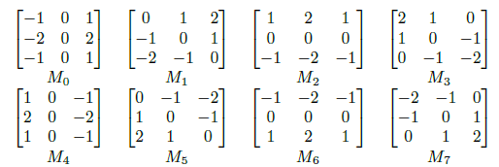
As Robinson compass masks are symmetric and generate the same magnitude response with different signs in opposite directions. Therefore, the use only four masks from M0 to M3 to find the principal directions, which can reduce calculation time.
As the earlier studies proved the patterns with high symmetry levels occur frequently in face images so Robinson compass can accommodate it.
So, in order to form a ternary pattern encoding the symmetrical representation by using four directional codes and the sign information.
This method assigns 2 bits to encode the primary directional number, and 2 bits for the secondary one; and each directional number has 2 bits for each ternary pattern.
Robinson compass masks

Slide 33
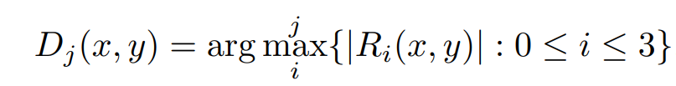
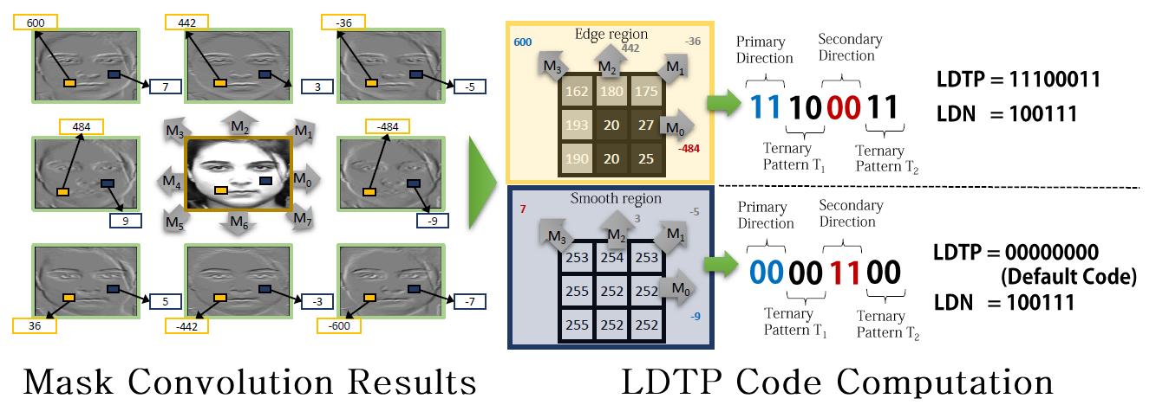
Step-2: Search for jth maximum absolute value Dj of the Robinson Compass mask’s.
Where,
‘arg j max i’ is an operator that returns the index i of the jth maximum value in the set.

Slide 34
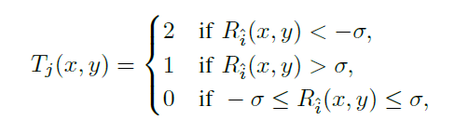
Step-3 : Find the Ternary pattern using the formula
The threshold divides the data only into three sections, upper, lower, and in between.
Upper means a strong positive and lower means a negative edge response, whereas in between means a weak edge response.
With this differentiation, it is possible to separate and keep the directional information from the edge response and ignore the directional information of the smooth areas.
If the ternary pattern from the first direction is 0, that means that the pixel (x; y) exists on a smooth area and therefore an empty code (0) is generated which later is being ignored.
If the ternary pattern from the second direction is 0, only the information of the first direction is meaningful and the knowledge of the second direction can be discarded.
Where,
‘Tj’ is the ternary pattern of the magnitude of the jth direction at position (x, y)
‘Rˆi (x, y)’ is the edge response of ˆith direction at position (x, y)
‘σ’ is a threshold value

Slide 35

Step-4 : Compute LDTP
The code is created by concatenating the binary form of the two principal directions and the two ternary patterns. This concatenation can be represented by the following operation
Step-5 : Compute the histogram based on the above obtained LDTP codes.
Where,
‘LDTP(x, y)’ is the code for each pixel (x, y) in the face image
‘D1’ and ‘D2’ are the direction number of the primary and secondary directions
‘T1’ and ‘T2’ are the first and second ternary patterns of the two directions

Slide 36
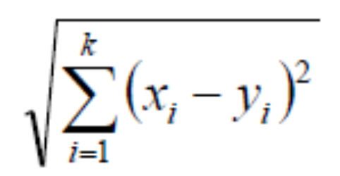
After Computing the Histograms using LDTP codes use the K-Nearest Neighbor algorithm as a classifier to get the facial expressions.
If f1,f2,….., fk are the feature vectors and (x, y) be the data points then by using the k-NN algorithm the distance from the new data to all other data that is already classified is computed using the formula
Labelling to the new data point is given based on the nearest neighbour

Slide 37
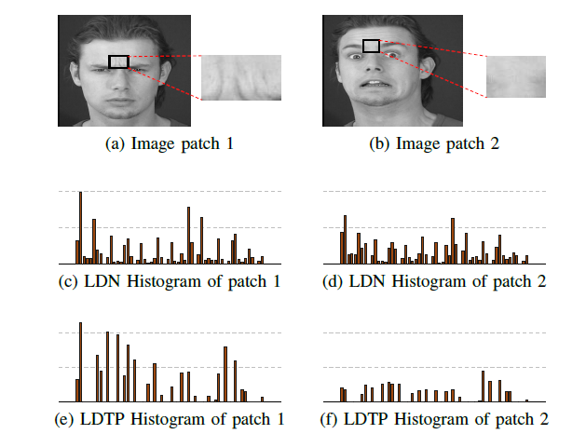
As our method utilizes edge magnitudes and encodes ternary patterns to discard useless ones, it is more discriminative than existing edge-based methods which only encode directions.
From the figure it is clear that the LDNs are the same for both the image patches whereas on the other hand LDTPs are not similar

Slide 38
RESULTS AND DISCUSSIONS
To validate the proposed method a random of 30 images from the CK+ were taken and served as input to the proposed method and calculated precision and recall.
The confusion matrix generated for these facial images are
Precision means the proportion of returned images that are positive
Precision is computed as ‘‘the number of correct positive predictions (TP) divided by the total number of positive predictions (TP + FP)’’. Precision is also known as a positive predictive value.
Precision= (TP) / (TP+FP)
Precision from the above confusion matrix is 75.0 Precent
9 (TP) | 3 (FP)
1 (FN) | 17 (TN)

Slide 39
Recall is defined as a Portion of positive images that are returned
Recall is computed as ‘‘the number of correct positive predictions (TP) divided by the total number of positives (P)’’.
Recall is also known as the true positive rate or sensitivity.
Recall = TP / (TP + FN)
Recall for the confusion matrix that is generated is 90 Percent
Accuracy is computed as ‘‘the total number of correct predictions, True Positive (TP)+True Negative (TN) divided by the total number of a dataset Positive (P)+Negative (N)’’.
Accuracy= (TP+TN) / ( TP+TN+FP+FN).
The Overall Accuracy of the proposed method is 86 Percent

Slide 40




OUTPUT
Detected Emotion is : Happy Detected Emotion is: Sad
Detected Emotion is: Angry Detected Emotion is: Surprise

Slide 41
CONCLUSION
A new local pattern, Local Directional Ternary Pattern (LDTP), that efficiently encodes shapes of emotion-related features by using the directional information has been proposed. For robust encoding LDTP incorporates ternary patterns that allow it to distinguish directional patterns on edge or smooth regions in which arbitrary, meaningless, and noise sensitive patterns are generated. The KNN classifier is used to test the performance of facial expression. The efficiency is analysed using Precision and recall.

Slide 42
REFERENCES
T. Ahonen, A. Hadid, and M. Pietikainen, “Face description with local binary patterns: Application to face recognition,” Pattern Analysis and Machine Intelligence, IEEE Transactions on, vol. 28, no. 12, pp. 2037–2041, 2006.
H. Hong, H. Neven, and C. von der Malsburg, “Online facial expression recognition based on personalized galleries,” in Automatic Face and Gesture Recognition, 1998. Proceedings. Third IEEE International Conference on, apr 1998, pp. 354 –359.
B. Zhang, Y. Gao, S. Zhao, and J. Liu, “Local derivative pattern versus local binary pattern: face recognition with high-order local pattern descriptor,” Image Processing, IEEE Transactions on, vol. 19, no. 2, pp. 533–544, 2010.
T. F. Cootes, G. J. Edwards, and C. J. Taylor, “Active appearance models,” IEEE Transactions on pattern analysis and machine intelligence, vol. 23, no. 6, pp. 681–685, 2001.
B. Zhang, Y. Gao, S. Zhao, and J. Liu, “Local derivative pattern versus local binary pattern: face recognition with high-order local pattern descriptor,” Image Processing, IEEE Transactions on, vol. 19, no. 2, pp. 533–544, 2010.

Slide 43
6. J. Yang, D. Zhang, A. F. Frangi, and J.-y. Yang, “Two-dimensional pca: a new approach to appearance-based face representation and recognition,” Pattern Analysis and Machine Intelligence.
7. M. Pantic, M. Valstar, R. Rademaker, and L. Maat, “Web-based database for facial expression analysis,” in Multimedia and Expo, 2005. ICME 2005.
8. M. Lyons, S. Akamatsu, M. Kamachi, and J. Gyoba, “Coding facial expressions with gabor wavelets,” in Automatic Face and Gesture Recognition, 1998. Proceedings.
9. P. Ekman, E. Rosenberg, and J. Hager, “Facial action coding system affect interpretation dictionary (facsaid),” 1998.
10. K. Etemad and R. Chellappa, “Discriminant analysis for recognition of human face images,” JOSA A, vol. 14, no. 8, pp. 1724–1733, 1997.
11. T. Jabid, M. H. Kabir, and O. Chae, “Robust facial expression recognition based on local directional pattern,” ETRI journal, vol. 32, no. 5, pp. 784–794, 2010.

Slide 44


